Slide 1


Cloud Foundry Overview
James Whittington -Client Executive
Michael Wright - Manager, Southeast Region
Matt Gunter - Platform Architect
January 2016

Slide 2


OUR MISSION:
Enable creation of high-quality software—at start-up speed—leveraging a modern cloud platform, a modern development process, and the power of Big Data to continuously drive innovation
Modern Software Methodology
Modern Cloud Platform
Big Data
Notes:
Businesses really face two very big challenges. How do they acquire the technical capability? How they transform the culture of the organization, to realize the full potential of these capabilities.

Slide 3

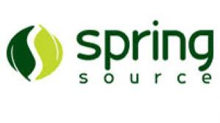
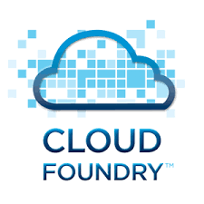
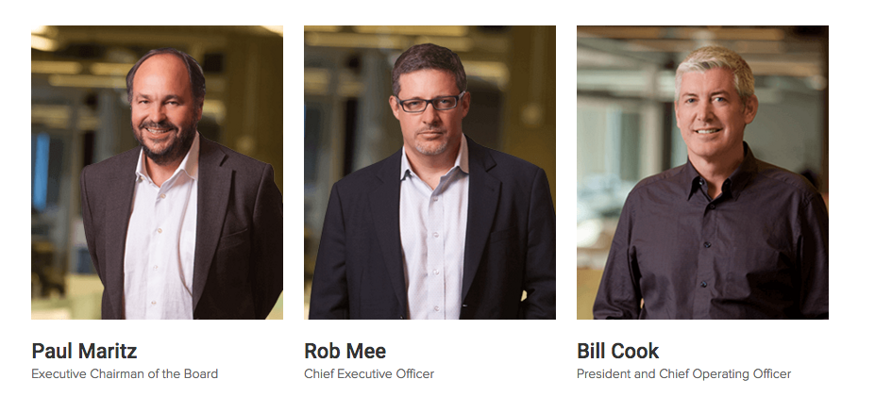
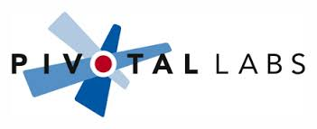
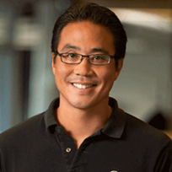

OUR FOUNDING STORY: 2012
Paul Maritz
Rob Mee
+1000 Employees
+$1B of Acquired Assets
+$1B Backing from EMC, VMware and GE
Bill Cook
Scott Yara

Slide 4
DIY Platforms
Cloud adoption with non-cloud native applications, un-opinionated tools and adhoc automation
Mesos
Kubernetes
Puppet
Spring Boot
SALT
Chef
Dropwizard
Amazon Web Services
Ansible
Docker
Chronos
Seneca
Ruby on Rails
Seneca
VMware vSphere
Azure
OpenStack
Application Frameworks
Container Schedulers
Automation
Tools
Cloud
Infrastructure
Notes:
How are many enterprise moving to an cloud native application designs? Technology bingo with different tools. A cloud and automation tools a-la-carte today, using a combination of individual cloud services or technologies: Just EC2 + services. Just Docker. Docker with Puppet/Chef/Ansible/SALT. MesosSphere or Kubernetes with Docker on EC2. etc etc.
Ad hoc tools are particularly difficult to update, the “Day 2” operation side. When you invest by combining all range of open source projects together,, you end up spending a huge amount of time working on integration. If you’ve got a dozen different open source projects in production, you’ll have to curate thousands of pull requests a wee,, into a secure package. This is an ongoing effort

Slide 5
Becoming Cloud Native
HARDER
CULTURE
The Cloud
Native Gap
OPERATIONS & RUNTIME
APPLICATION ARCHITECTURE
EASIER
Notes:
Application Architecture
Operations & Runtime
Culture
UG example – which attributes relate to them – call one out
Micro services
12 factor App
Polyglot buildpacks
Spring Boot/Spring Cloud
Automate Infrastructure
Manage services, not servers
Container Orchestration
DevOps
Continuous Delivery
Developer Self Service
Test driven development

Slide 6


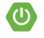



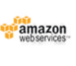
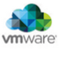
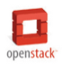
Culture
Cloud Native Framework
Tools
Application Framework
Dev
Contract: 12 Factor App
Spring Cloud
Spring Cloud
Runtime Platform
Dev
IT Ops
Contract: BOSH Release
Cloud Foundry
Infrastructure Automation
Contract: Cloud Provider Interface
BOSH
Infrastructure
IT Ops
AWS VMWare OpenStack
Notes:
Pivotal breaks down cloud native technology into 3 layers, which is all supported, reinforced and optimized by cloud native culture.
At the bottom, we have API driven cloud native infrastructure automation. This abstracts the provisioning and configuration of computing, networking and storage resources.
Then we have a cloud native container scheduling runtime responsible for building, running and operating applications.
The top layer consists of frameworks that enable the rapid development of cloud native applications with reusable components and patterns.

Slide 7
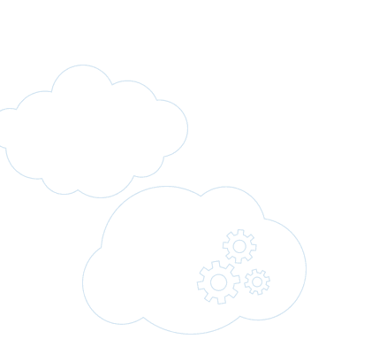

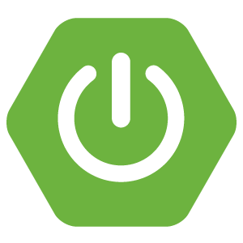
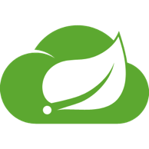
Application Framework
Cloud native application patters need a modern design paradigm
Spring
Leader in Enterprise Java
Spring Boot
Productivity Accelerator
Spring Cloud
Anti-Fragility Made Easy

Slide 8

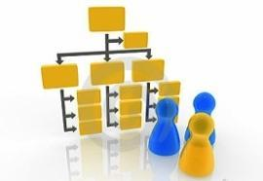
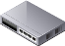



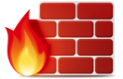
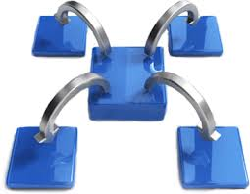


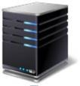
Pivotal CF Capabilities At A Glance
Automatic
Configuration with Buildpacks
Role Management
Containerization
Services: Data, Mobile & Platform
Application Security Groups
Log Aggregation and Ops Metrics
Services Binding and Access
High Availability
Load Balancing,
Rapid Scaling
IaaS Provisioning
& Configuration
Notes:
WHAT
Pivotal CF is next generation middleware that delivers 9 things that are typically delivered via point software products.
We provision operating systems and middleware.
We deliver workload density without compromising application performance.
We ensure that applications have appropriate network security safe guards to prevent security threats.
We support application connections to external sources including databases and legacy middleware.
We provide 4 levels of HA, with built in load balancing for scale in/out
We support multi-tenant environments so that each line of business can operate with a discrete quota and isolated system access.
We provision next generation data services including NOSQL databases, traditional databases and hadoop clusters.
We provide horizontal and vertical scaling for the underlying IaaS so that you can scale your infrastructure in lock step with your Business.
We provide a built-in log aggregation service, built-in APM metrics and utilization based auto-scaling so that you can monitor the health of your applications and scale out without human or 3rd party tool intervention.
I am going to cover each of these 9 capabilities in more detail, but it’s important to note the impact of this collection of capabilities. The following slides will include information on CAPEX and OPEX reduction. We will also discuss how you can deliver faster time to value while holding the line on infrastructure cost.

Slide 9

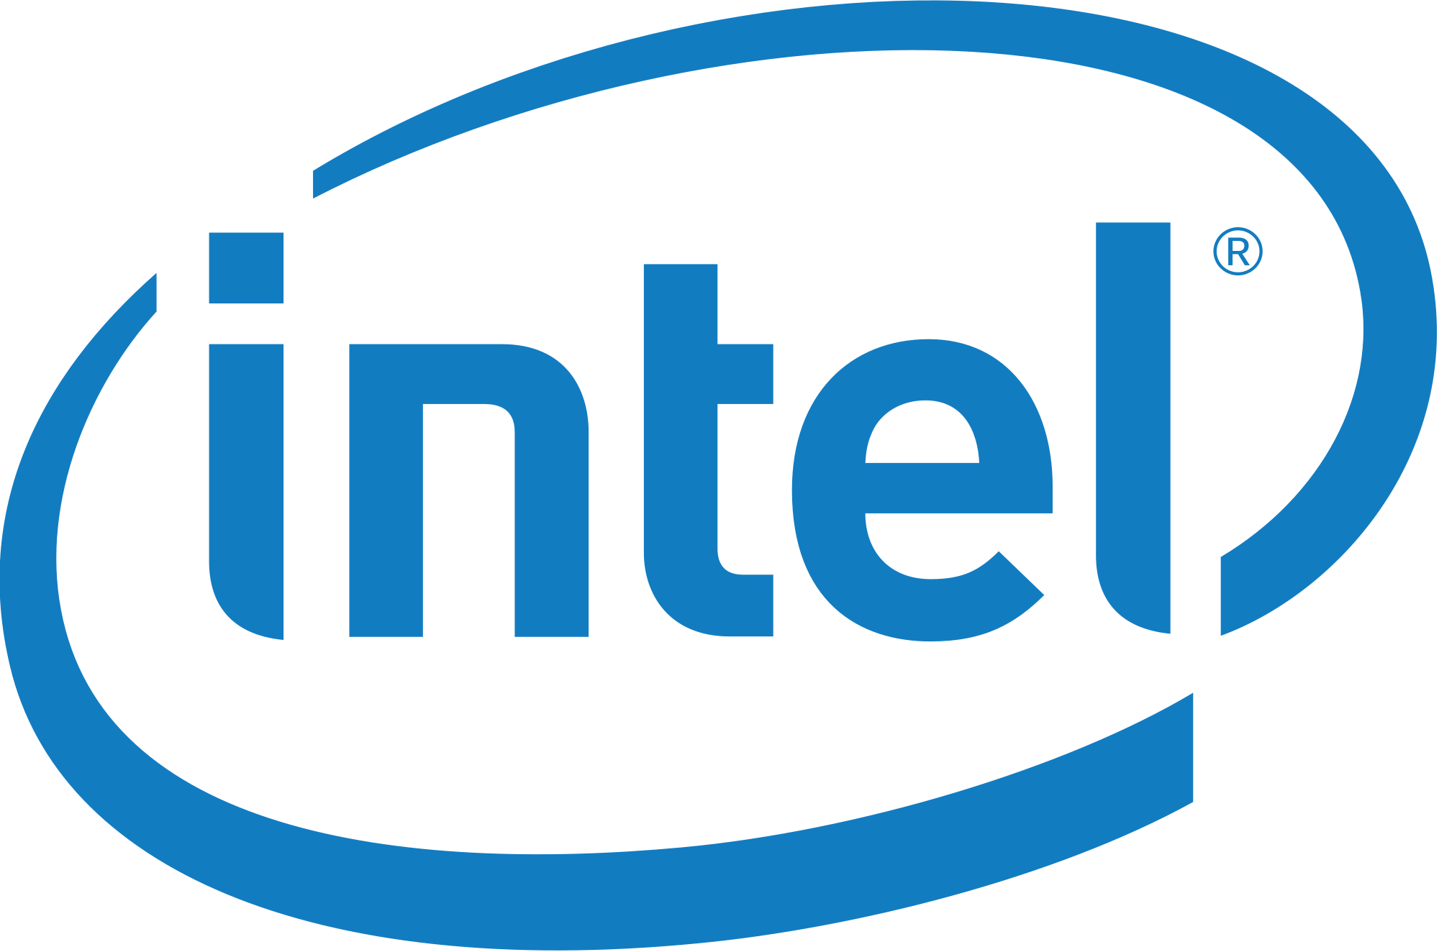
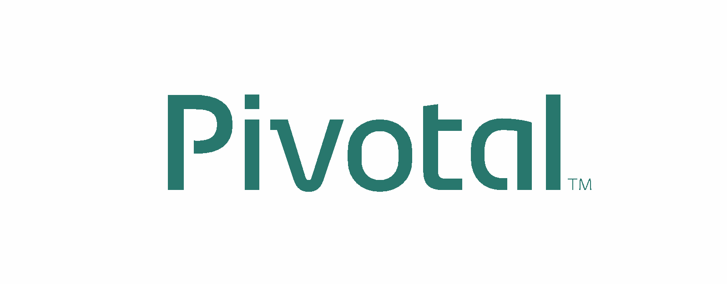
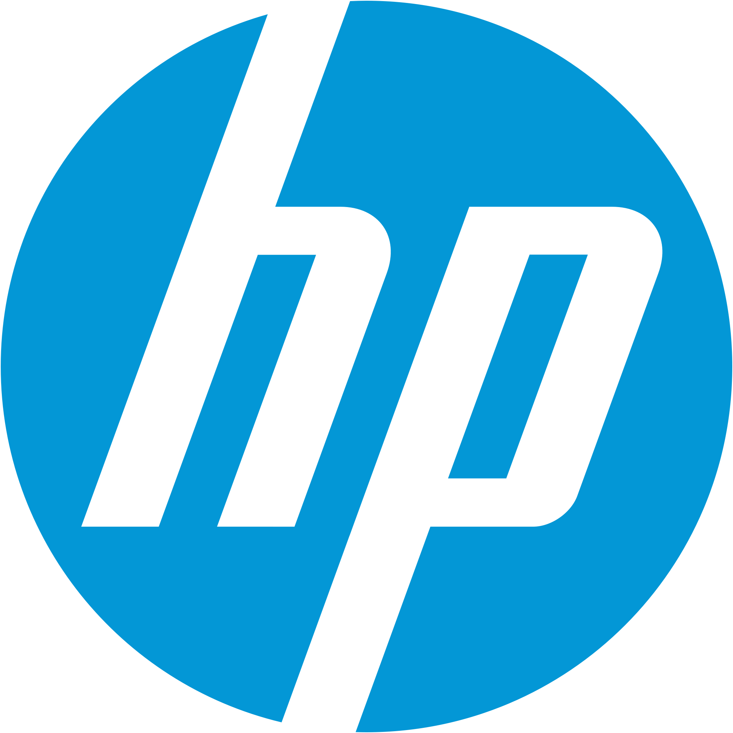
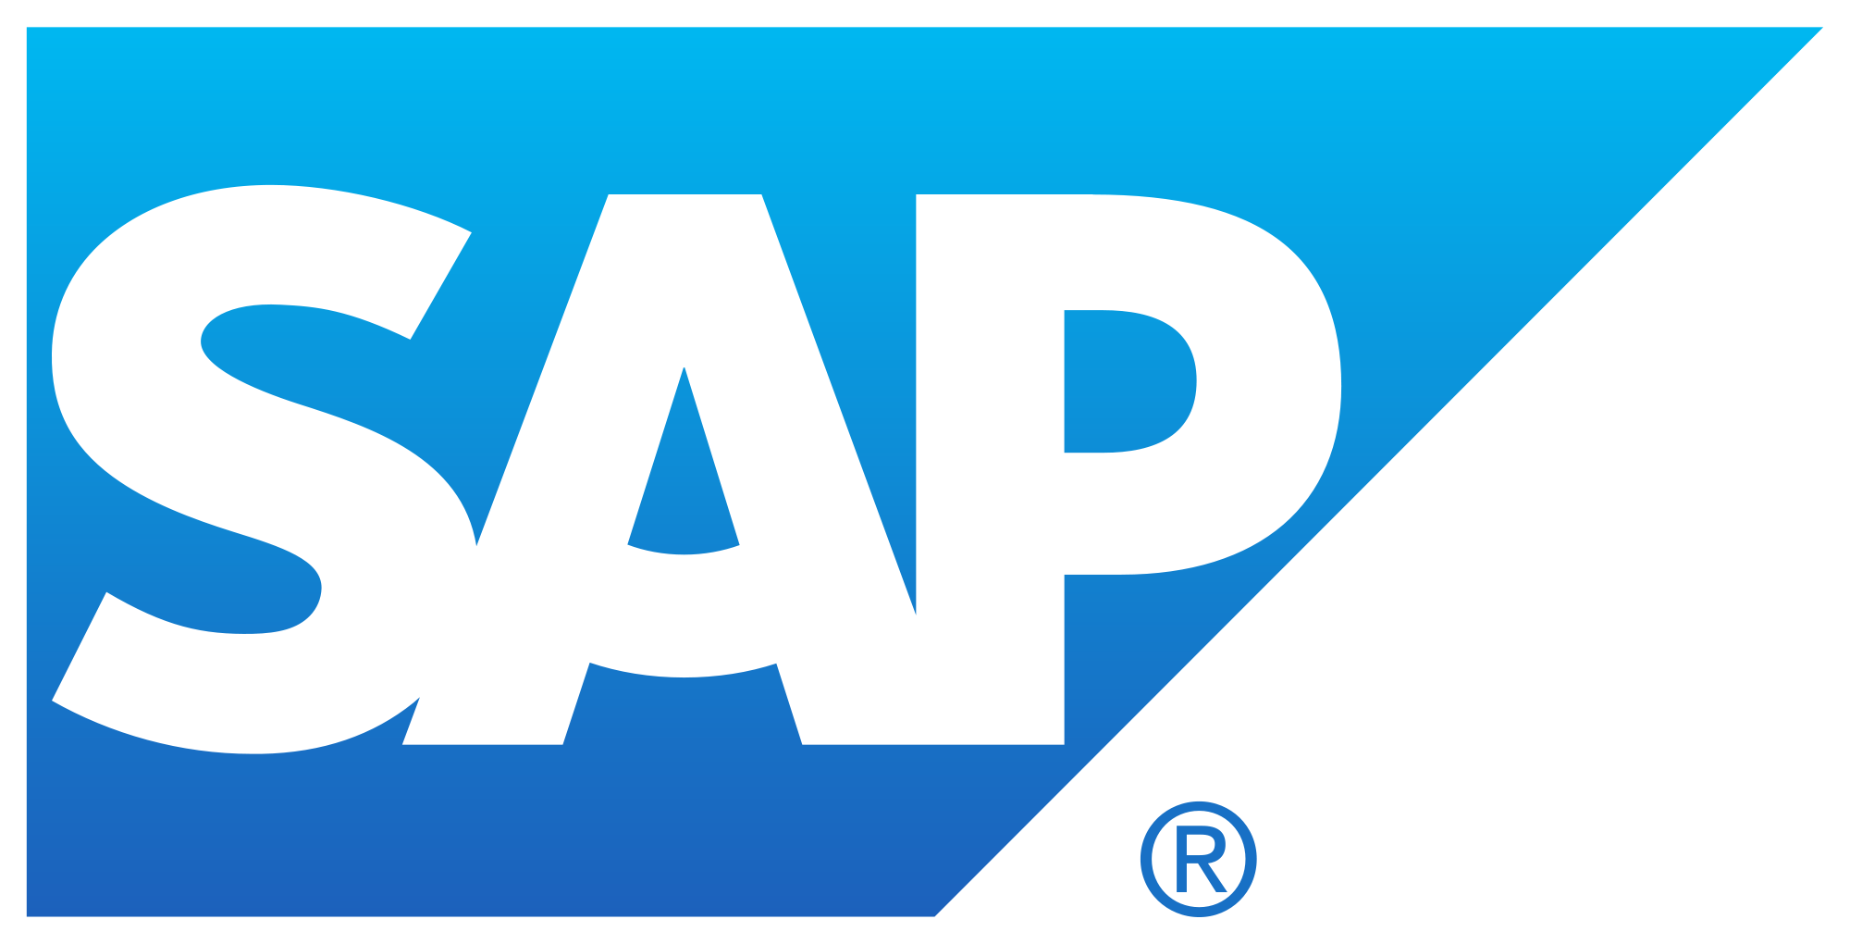
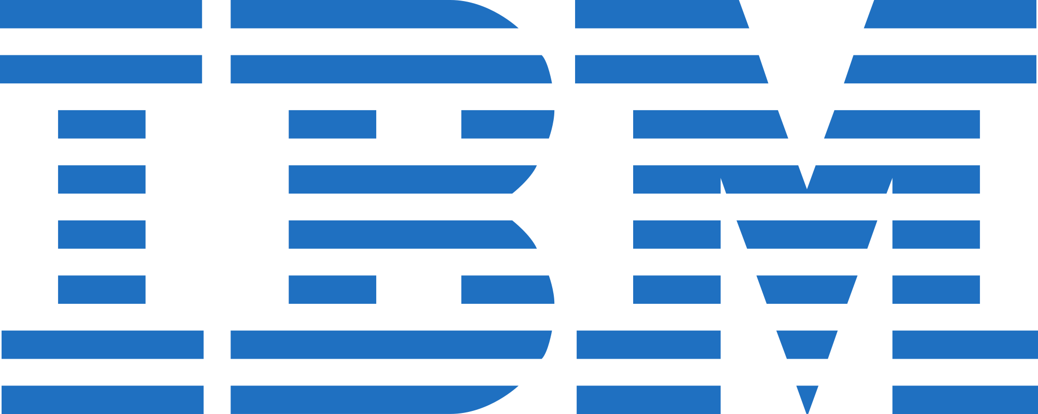


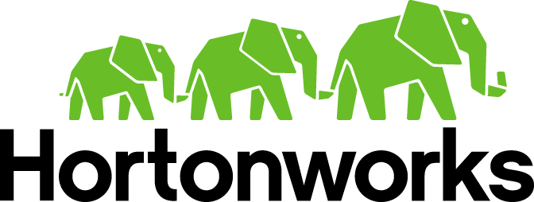
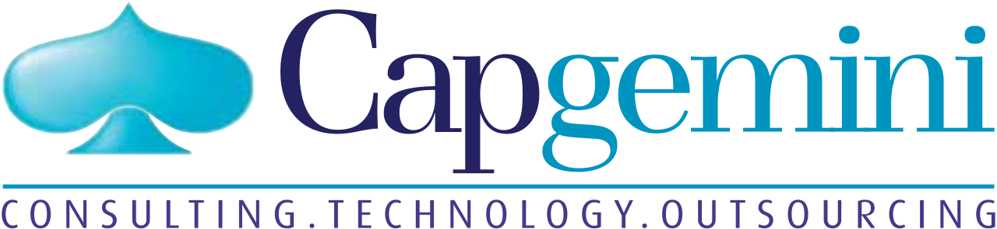


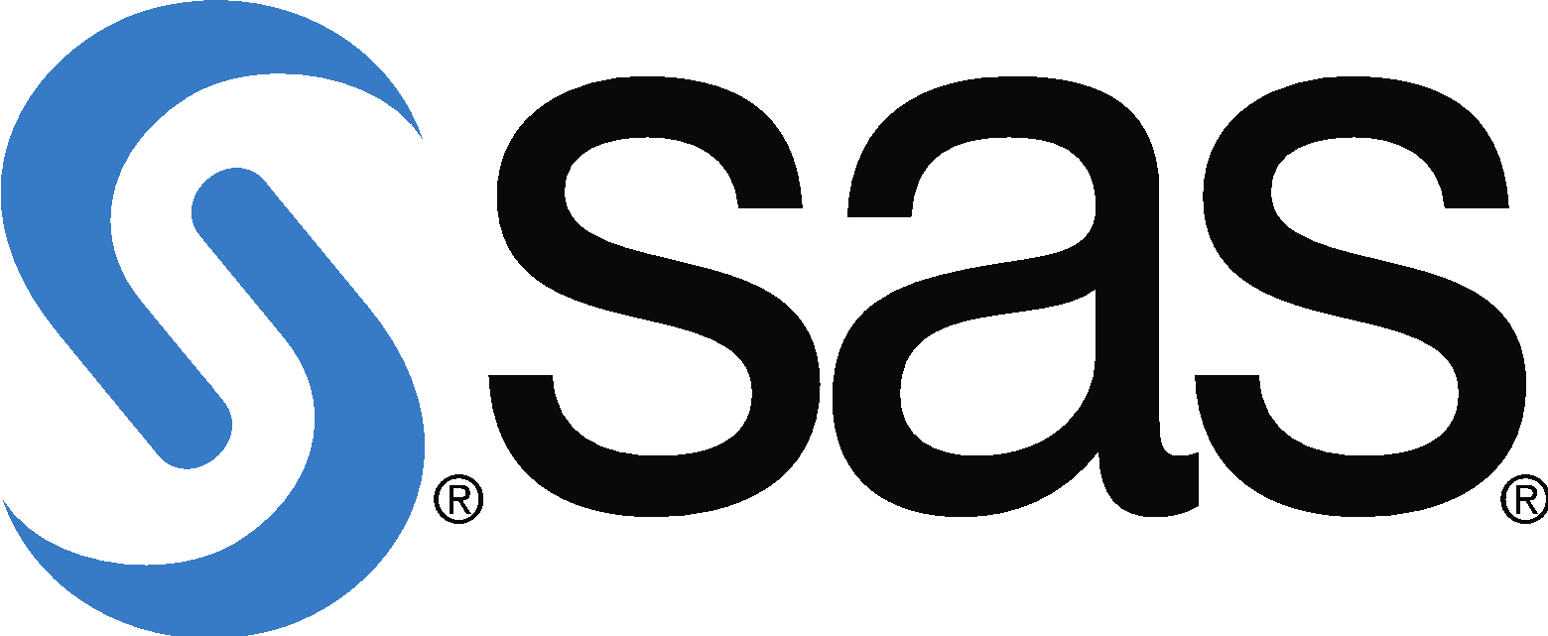
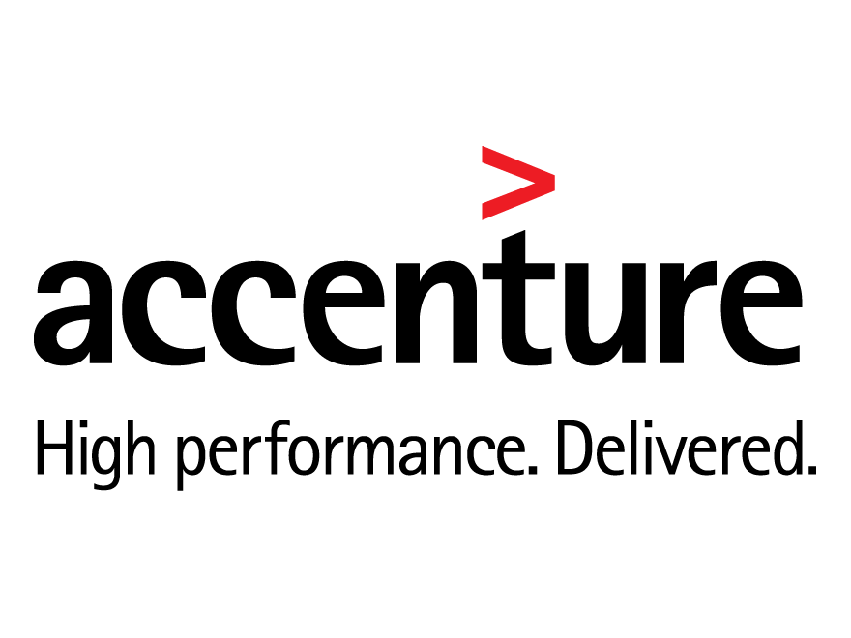
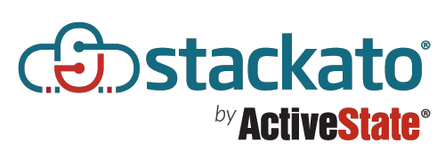
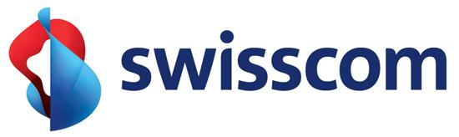
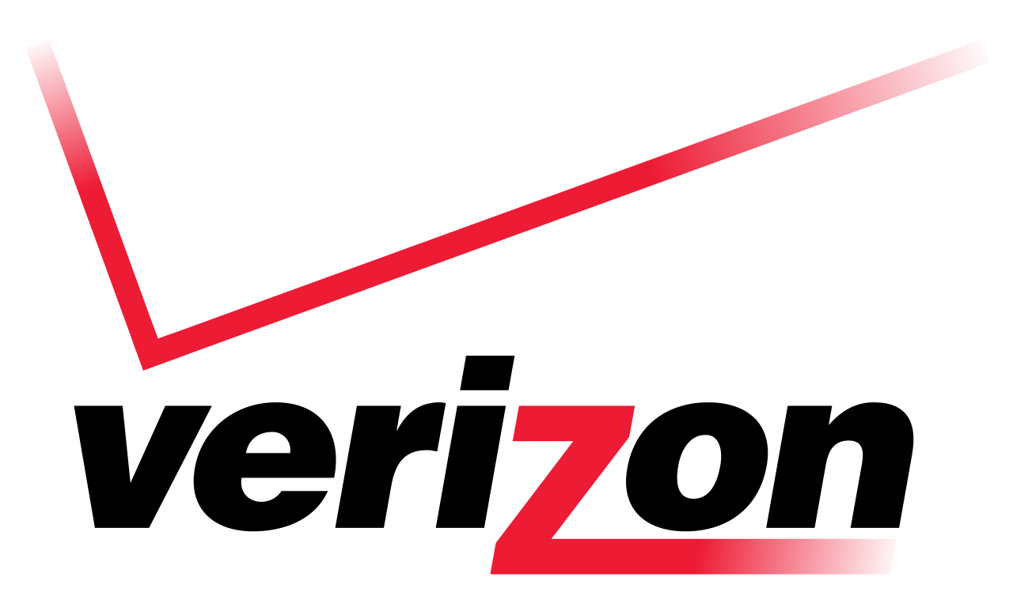
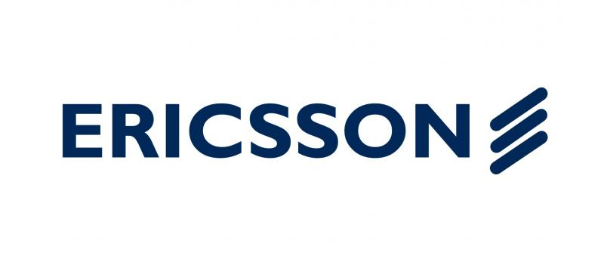
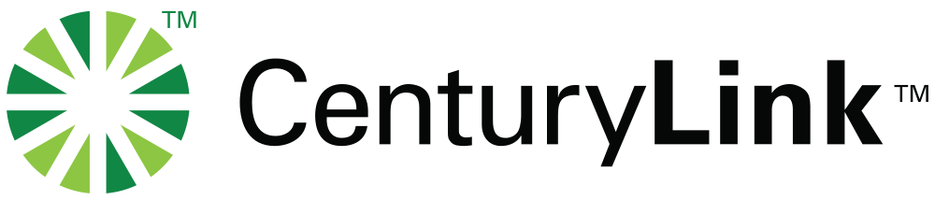
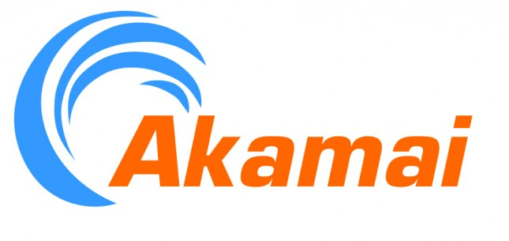
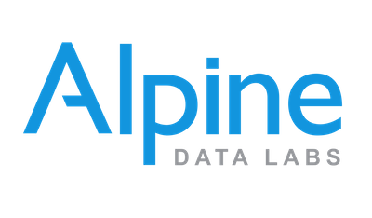
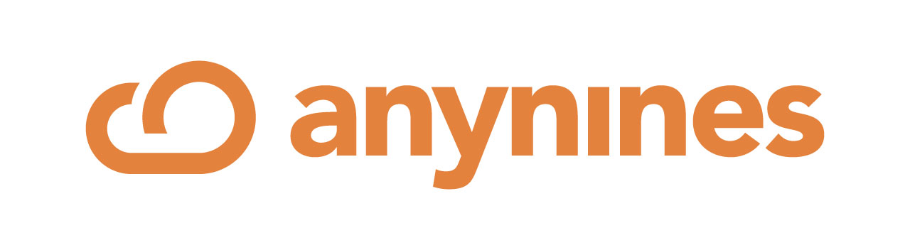
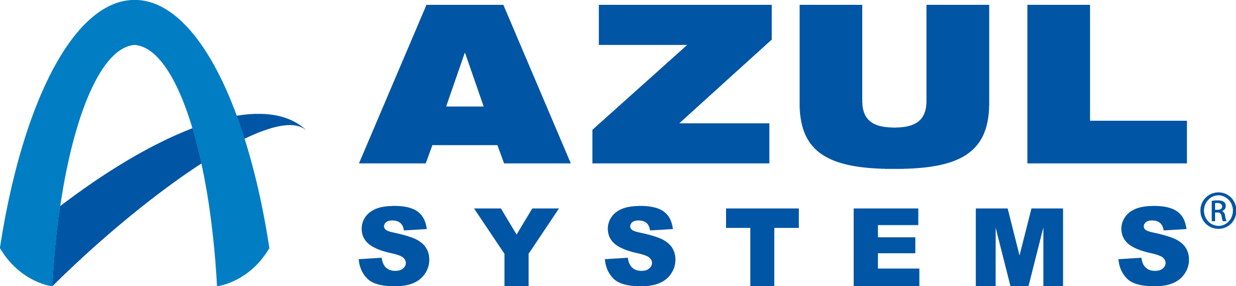

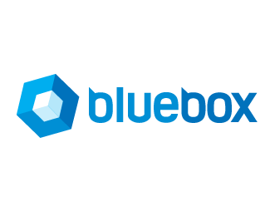

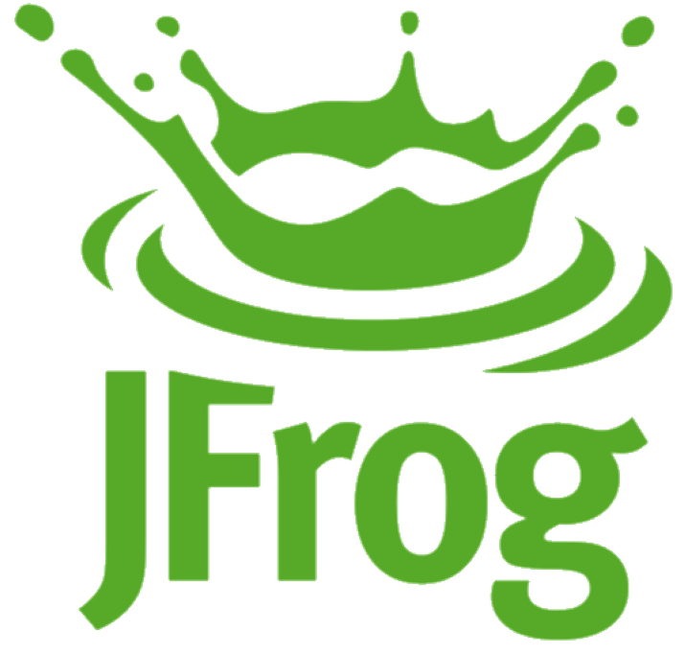
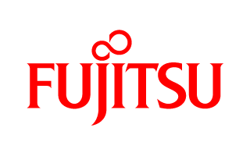
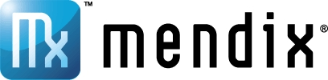
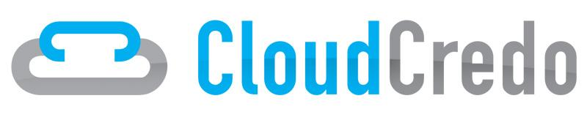
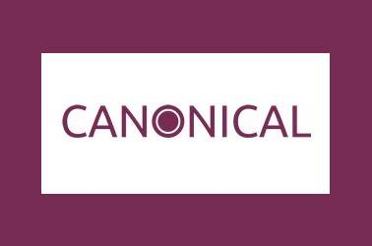

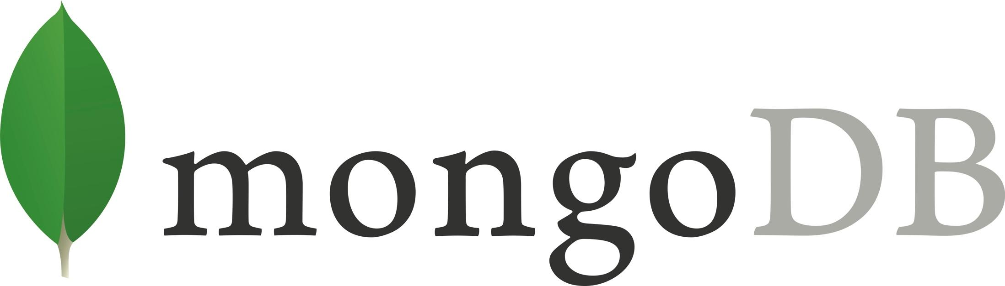
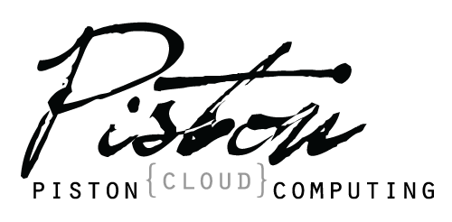

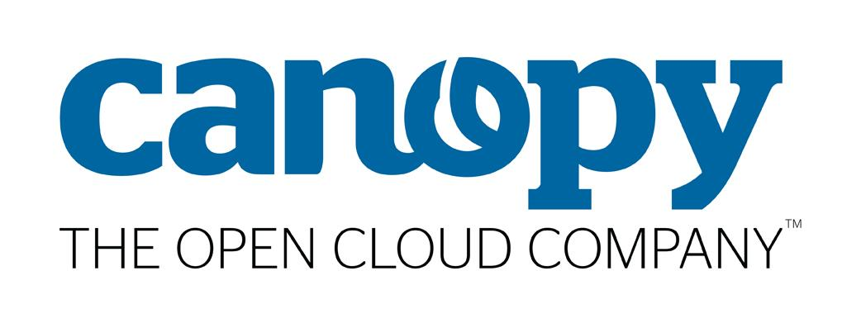



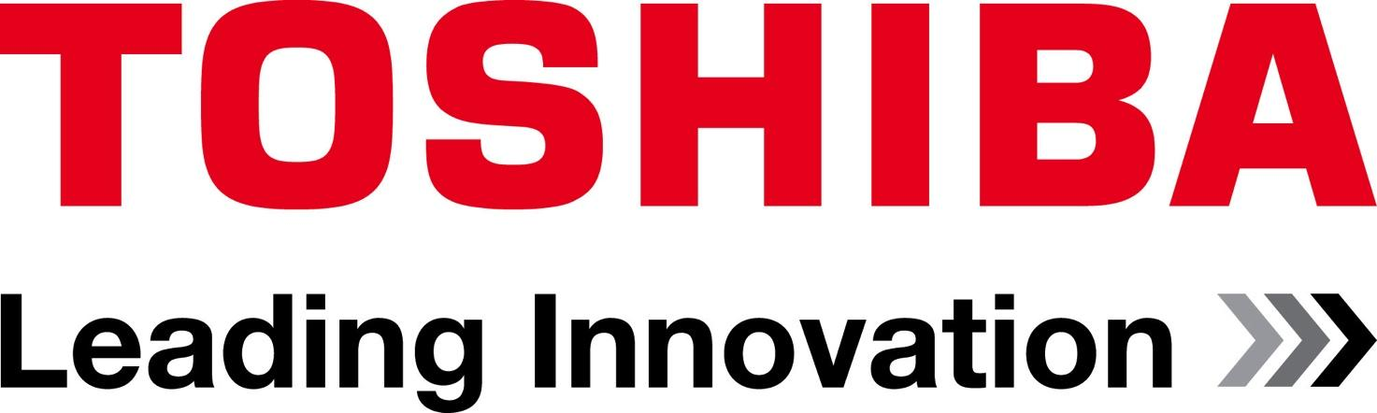
Cloud Foundry: The Industry’s Open Standard
PLATINUM
GOLD
SILVER
Notes:
Not only did we start from day one on an open-source basis, but we went out of our way to recruit others in the industry to join with us in a Foundation. Our partners in the governance of that foundation include IBM, HP, SAP, Intel, and about 40 other companies. The biggest technology companies in the world are rallying behind Cloud Foundry to make it the open cloud standard for the industry and allow enterprises of any size and scale to build modern cloud applications, whether that really starts in their data center or they start using hybrid or public cloud infrastructures.

Slide 10

Let’s build something MEANINGFUL

Slide 11
Deployment Demo:
Push an App
Bind a Service
Scale

Slide 12

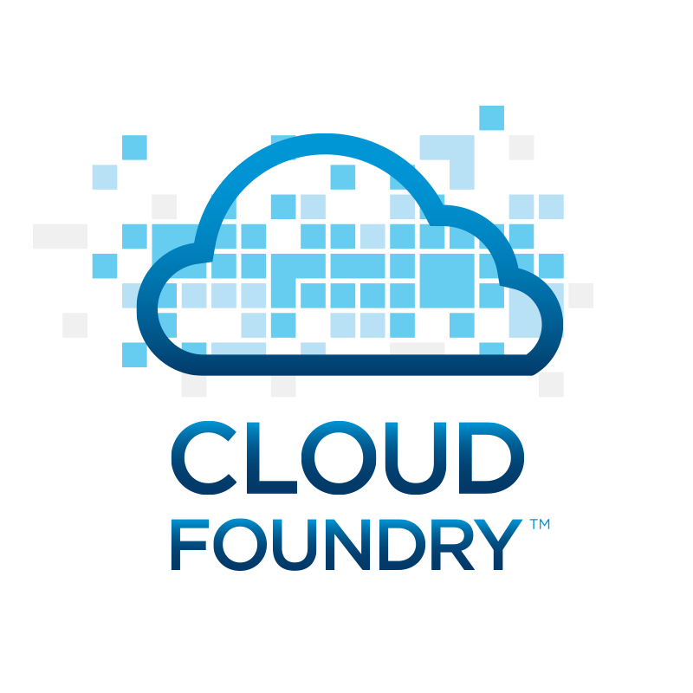
Pushing an application
Blobstore
DB
SC
push app
+ app MD
Cloud Controller
Service Broker
Node(s)
Router
Upload bits/metadata
Create/bind services
Stage app
Deploy app
Diego
Diego
Diego
+
=
Diego
+
=
+
=
+
=
Runtime

Slide 13
Developer Options when Pushing an App
Memory
Scale
Manifest
Services
Url/Host
Default route vs. existing route

Slide 14

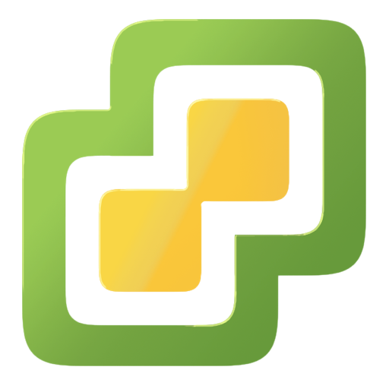
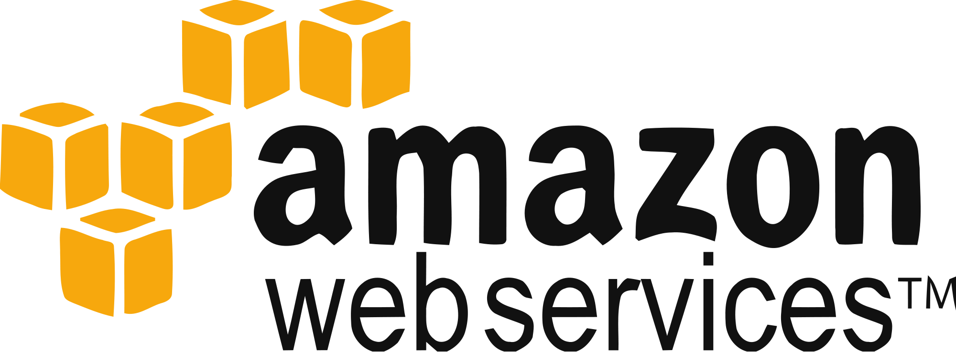
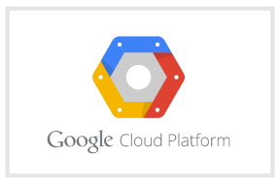
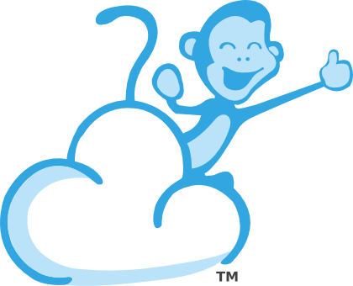
Cloud Foundry Architecture Stack
Router
Cloud Controller
UAA/Login Servers
Health Manager
Service Broker Node(s)
Diego Pool
Loggregator

Messaging (NATS)
BOSH Director
BOSH Agent
IaaS

Slide 15


Diego Cells Support Linux, Docker, and Windows
Ruby
Notes:
This figure shows that in PCF 1.6 it is possible to deploy .net and docker apps alongside with a buildpack app, that here is represented by a spring and a ruby app. Spring, Ruby and docker containers are running side by side in the same linux host that is provisioned and managed by the platform, while the .NET app is running on a windows host that is provisioned and managed by the customer.
The platform is improving support for Microsoft-based development with the general availability of .NET application workloads on Windows. The new platform runtime adds support for Windows Server 2012 R2 workloads with lifecycle management and backing services (windows hosts are not bosh managed for this version) . Developers can deploy any .NET application that follows 12-factor design patterns using standard Cloud Foundry CLI commands:
cf push APPNAME -s windows2012R2 -b binary_buildpack
The new platform runtime includes native support for deploying Docker container images with platform-managed health management, scaling and backing services. This public beta release supports image deployments from secure, public registries such as Docker Hub via a standard CLI command:
cf push APPNAME -o user/docker-image
Docker support currently has several documented caveats (https://docs.pivotal.io/pivotalcf/concepts/docker.html#caveatsthat are being improved for the upcoming GA release.

Slide 16
Application Staging
Blobstore
DB
Cloud Controller
Router
Diego
System
Buildpacks
Detect
Compile
Upload
Yes
No
+
=
Runtime
Runtime

Slide 17
Application containers and scaling
Blobstore
Cloud Controller
Messaging (NATS)
Access App
Router
Diego
Diego
Diego
Runtime

Slide 18
Service create and bind
DB
Service
credentials
CLI
create service (HTTP)
Cloud Controller
create service (HTTP)
Service
Broker
reserve resources
Data
Service
Router
bind service (HTTP)
bind service (HTTP)
obtain connection data
Runtime

Slide 19







PCF Suite
Product compatibility certified by Pivotal
Released & Patched as a cohesive collection on Pivotal Network
OPS
Manager
Elastic
Runtime
OPS
Metrics
MySQL
RabbitMQ
Redis
GemFire
SSC
Notes:
And now you you can get all these products at once, released & patched as a cohesive collction on Pivnet…introducing PCF suite: Ops Mgr + ERS + Ops Metrics + MySQL + RabbitMQ + Redis + GemFire

Slide 20







Security and Operations Pivotal Single Sign-On – Universal Identity Broker
Customer
Apps
OAuth / OpenID
Employee
Apps
OAuth / OpenID
Authenticate
SSO
Service
SAML
Partner
Apps
OAuth / OpenID
Notes:
The Single Sign-On Service on PCF offers a turnkey solution that enables strong application security while easing user experience. This technology release is based on standards like OAuth, OpenID Connect, and SAML 2.0. Our objective is to offer developers a simplified experience while making it easy for operators to deploy, configure and maintain the service. The service has been certified by industry-leading, federated identity providers like Ping Identity, CA SSO (formerly CA SiteMinder), Azure ADFS, ForgeRock OpenAM, VMware Identity Management, and Okta. Adopting other compliant identity standard providers requires little effort to integrate and validate.

Slide 21






Complete Toolchain for CI/CD High Quality Software, Faster and Continuously From Idea to Production
AUTOMATION.
Integrate tools and automate processes from testing to builds and deployment
SPEED.
Release more frequently with smaller bits will reduce complexity and improve time-to-market
QUALITY.
Reduce feedback loop using test-driven development to surface problems sooner and be responsive
AGILITY.
Push updates on regular basis with no downtime to improve customer experience and time to market
Commit Code Change
Automate Build & Test
(Unit Test, Static Code Analysis)
Store Binaries & Build Artifacts
Automated Integration Testing
Acceptance, Performance & Load
Zero Downtime Upgrade to Production
Build Pipeline Operations
Tool Chain
Gitlab
Jenkins
Development
Test + UAT + Staging
Production
Distributed revision control and source code management. Collaborative software development.
Build, test and deploy software projects continuously and incrementally. Thousands of compatible plugins.
Share binaries and manage distributions. Manage artifact lifecycle.
Develop, test, QA and production on the same platform. Simple, developer friendly commands and APIs. Operational benefits for every app. Built-in ecosystem services. Deploy, operate and scale on any IAAS
Notes:
Although a critical critical element of continuous delivery, the ability to build, test and deploy code quickly and reliably via this toolchain is only half the story. Continuous delivery is a business goal and measured in the delivery of software functionality to customers, not in the delivery of bits to machines. As such, a holistic interpretation of continuous delivery must expand to include production concerns for applications. Only when deployed software can remain scalable, highly available, secure, and updateable in production—all without downtime—should it be deemed “delivered.”
Not only does PCF provide such operational excellence for the applications in production, but it also does so for the GitLab, CloudBees Jenkins and JFrog Artifactory services themselves. Integrating these services for streamlined delivery of code with PCF provides a reliable, turnkey, end-to-end platform for continuous delivery. It’s what enables Pivotal customers to get ideas from conception to production in less than a day, which in this day and age, is a truly strategic advantage.

Slide 22

Microservices provide benefits…
Notes:
"Many development teams have found the microservices architectural style to be a superior approach to a monolithic architecture, but like any architectural style, microservices bring costs and benefits.
Some of the benefits are:
Strong Module Boundaries: Microservices reinforce modular structure, which is particularly important for larger teams.
Independent Deployment (Deployment of smaller pieces with lower risk): Simple services are easier to deploy, and since they are autonomous, are less likely to cause system failures when they go wrong
Selective scaling: if one service gets a lot of load you can scale just it, rather than the entire application
Technology Diversity/Heteregeneous technology landscape: With microservices you can mix multiple languages, development frameworks and data-storage technologies.

Slide 23

Spring Cloud Services for PCF
Helping to solve microservices challenges
First and only secure, enterprise-ready distribution of core NetflixOSS and Spring Cloud components
Abstracts complexity of software patterns for distributed applications
Developers can focus on building differentiated capabilities
Notes:
Note: Spring Cloud Services is a subset of Spring Cloud, which is a subset of Netflix OSS. Make sure the picture is not misinterpreted.
Spring Cloud Services provides the first and only secure, enterprise-ready distribution of core NetflixOSS and Spring Cloud components, specifically geared toward providing proper architectural scaffolding for microservices applications. SCS 1.0 operationalizes these components as managed services within PCF, including a configuration server, service registry, and circuit breaker dashboard service.
Each of these components is made available from the Pivotal Cloud Foundry services marketplace. The service catalog is presented to Pivotal Cloud Foundry by a service broker—behind the scenes, it manages each developer-created service instance as applications deployed to Pivotal Cloud Foundry! As such, they benefit from all of the operational capabilities provided by Pivotal Cloud Foundry

Slide 24
Custom Services
Broker
Custom User-Provided Service

Slide 25
IaaS Demo:
Review Ops Manger & CF VM’s
Review IaaS Loadbalancer Configuration
Show distinction between Tiles, App Instances and VM’s
Show how PCF recovers an App
Show how BOSH recovers a VM.

Slide 26







Multi-IaaS support with deployment options
Public
Private
Pivotal manages
Customer manages
Notes:
Because we do everything from the cloud API the whole way up, the platform operator has push button control of the whole stack including the OS. This same layer deploys manages and scales the platform runtime and data services on your cloud API of choice. Open application and orchestration standards enable operators to migrate apps between any prevalent cloud (i.e. VMware vSphere, OpenStack, and Amazon Web Services). This gives IT organizations unprecedented “write once, deploy anywhere” flexibility on their choice of infrastructure to take advantage of new features and pricing without needing to refactor or rebuild applications”.

Slide 27

CenturyLink Announcement

Slide 28

Mirantis – Pivotal
Notes:
Here at Rackspace, we’re pretty big fans of the as-a-service concept; it’s at the core of what we do. Let’s take OpenStack, for example. This five-year-old open source cloud platform continues to gain fans and users. It’s no longer the sole domain of born-in-the-cloud companies like Ebay and PayPal using OpenStack for their production environments. Nnon-cloud-native enterprises like Best Buy, BMW, Comcast, Disney and Wal-Mart have also climbed on board.
But still too often, OpenStack adopters choose the wrong consumption model to suit their needs, leading to misaligned expectations, writes Christian Foster, Rackspace’s Senior Director of Marketing for the OpenStack Cloud this week in InfoWorld.
Sure, you can DIY OpenStack, or consume it as a commercial distribution. But, he cautions, “unless you have an internal center of deep expertise, OpenStack is best consumed as a service.”
https://blog.rackspace.com/the-download-openstack-as-a-service/

Slide 29










Ops Manager + BOSH
IaaS
DB
BOSH
Deploy my
Services
BOSH Director
Worker VMs
Blobstore
NATS
Messaging
Health Manager
Health
Monitor
Cloud Controller
Target VM

Slide 30


Multi-Tenant Features: Orgs, Spaces, Users and Quotas

Slide 31



Platform Monitoring
JMX Monitoring Tool
JMX Provider
Collector
(Diego)

Slide 32
Purpose-built for “Day 2 Operations”
Consistent, Reliable, Scalable, Secure
Provision
Deploy and Configure
Checks against “desired state to return consistency
No ad hoc automation burden
Manage services, not servers
4 layers of Self Healing
Current
State
Desired
State
Re-mediate
Monitor and Detect
Notes:
We talk about PCF providing an abstraction layer over VMs providing lifecycle management of large scale distributed services. It was designed with the assumption that complex systems will develop inconsistencies over time. So platform was purpose-built for what you might call “day 2 operations”. The previous generations of configuration tools leave a lot of ad hoc orchestration burden on operators to build and run a service. The difference with BOSH is that it isn’t told what to do, but its told the desired state of what it should be, and then it does the right things to make that be true. The constant checking, detection and remediation make sure that state always returns to consistency.
This resiliency is what makes PCF an excellent infrastructure abstraction layer. It mediates with the infrastructure, draws from pools of resources in order to deploy distributed services like the Elastic runtime, data services, messaging layer, CI system & others. Now operators can provision services to developers instead of machines
[[For a longer discussion , you can even discuss that BOSH together with Runtime, provides the 4 layers of HA - App Instances, processes, VMs , AZs]]
Check if we want to call out BOSH by name or just say infra automation layer

Slide 33
Each Layer Upgradable with Zero Downtime
Application layer
Blue Green deployment
Runtime layer*
Blue Green deployment
OS image
Canary style
No downtime
Linux host & kernel
* Devs may bring a custom buildpack

Slide 34
PCF Hosted Edition Options
 | On Premise | Public Cloud
Customer Managed | PCF for vSphere PCF for Open Stack | PCF for AWS PCF for Azure (2016)
Non-Customer Managed | N/A | Hosted PCF by CTL Hosted PCF by Accenture Pivotal Operated PCF for AWS Pivotal Operated PCF for Azure
 |  | PWS-E (Multi-tenant)

Slide 35
What’s on Pivotal CF for an operator?

Slide 36


Pivotal CF operations
Developer
Operator

Slide 37


Deploy to dev
Install runtime and container

Slide 38

Install runtime and container
Deploy to dev
Install services (db,
messaging, hadoop, …)

Slide 39

Install runtime and container
Deploy to dev
Install services (db,
messaging, hadoop, …)
Setup load-balancing, SSL termination and dynamic routing

Slide 40

Install runtime and container
Deploy to dev
Install services (db,
messaging, hadoop, …)
Setup load-balancing, SSL termination and dynamic routing
Setup / config High Availability

Slide 41

Install runtime and container
Deploy to dev
Install services (db,
messaging, hadoop, …)
Setup load-balancing, SSL termination and dynamic routing
Setup / config High Availability
Setup APM

Slide 42

Install runtime and container
Deploy to dev
Install services (db,
messaging, hadoop, …)
Setup load-balancing, SSL termination and dynamic routing
Setup / config High Availability
Setup APM
Setup log streaming

Slide 43




Install runtime and container
Deploy to dev
Install services (db,
messaging, hadoop, …)
Setup load-balancing, SSL termination and dynamic routing
Setup / config High Availability
App Deployed
Setup APM
Setup log streaming

Slide 44
Blue-green deployment
Restart server
Upgrade app
Install runtime and container
Deploy to Test
Create service
Change JDK
Deploy to dev
Redeploy
Install services (db,
messaging, hadoop, …)
Scale Platform
Scale up
Bind service
Update app
Setup load-balancing and dynamic routing
Deploy to QA
Update app server
Unbind service
Setup / config High Availability
Change route
Promote to production
Setup APM
Scale memory
Check logs
Setup log streaming
Scale down
Delete App

Slide 45

Blue-green deployment
Restart server
Upgrade app
Install runtime and container
Deploy to Test
Create service
Change JDK
Deploy to dev
Redeploy
Install services (db,
messaging, hadoop, …)
Scale Platform
Scale up
Bind service
Update app
Setup load-balancing and dynamic routing
Deploy to QA
Update app server
Unbind service
Setup / config High Availability
Change route
Promote to production
Setup APM
Scale memory
Check logs
Setup log streaming
Scale down
Delete App

Slide 46
The Pivotal CF way
Deploy to dev

Slide 47








The Pivotal CF way
Deploy to dev
Cloud
Controller
Health Manager
> cf push
NATS
(message bus)
App Deployed
Router
Router

Slide 48
The operator in the PaaS era
Developer
Operator

Slide 49


The operator in the PaaS era

Slide 50





Plan capacity
Setup High Availability
Install the platform
Operator Concerns
Manage users
and quotas
Handle upgrades and updates
Monitor the platform

Slide 51


Install the platform
Setup High Availability
Pivotal CF
Install and manage services
Target multiple clouds
IaaS
Handle live upgrades and updates
Scale and
plan capacity

Slide 52












CloudBees Jenkins
Enterprise
Cassandra
for Pivotal CF
ElasticSearch
for Pivotal CF
Mobile Services
for Pivotal CF
BOSH Director
BOSH Agent
IaaS

Slide 53
Click to install
Zero downtime updates
Explore install logs
Click to scale the platform
CloudBees Jenkins
Enterprise
Built-in High Availability
Cassandra
for Pivotal CF
Built-in Platform Monitoring
ElasticSearch
for Pivotal CF
Mobile Services
for Pivotal CF
BOSH Director
BOSH Agent
Integrated services
IaaS

